Slide 1
upLift
Kayla Cinnamon, Caitlin Connerney, Ezra Dowd, Stefan Steenstrup, Crystal Yee
Notes:
Cactai

Slide 2
AGENDA
Problem
Solution
Project Plan
Task Assignments
Technologies and Architecture
Demo
Future Plans
Conclusions
Q & A
Notes:
Cactai

Slide 3
1.
THE PROBLEM
Notes:
Kayla

Slide 4
Most workout applications are overcomplicated and make it difficult to create custom workouts.
Notes:
Kayla

Slide 5
2.
OUR SOLUTION
Notes:
Kayla

Slide 6
A workout application catered towards experienced fitness users. The user can create new, custom workout routines and track their progress as they complete each one.
Notes:
Kayla

Slide 7
3.
PROJECT PLAN
Notes:
Caitlin

Slide 8
WE USED THE AGILE SOFTWARE MANAGEMENT MODEL
Plan - Task List
Collaborate - Weekly Meetings
Deliver - Weekly Sprints
Repeat
Notes:
Caitlin

Slide 9
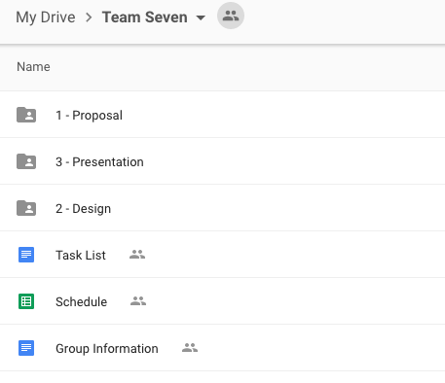

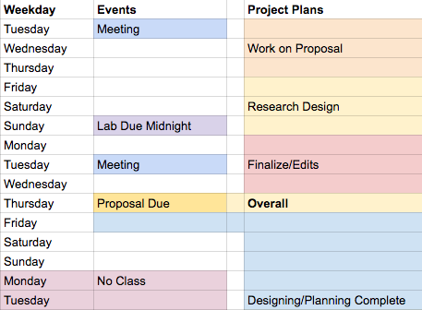
TASK ORGANIZATION
Notes:
Caitlin

Slide 10
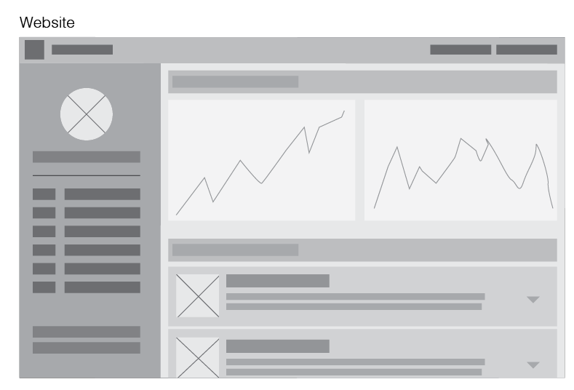
DESKTOP LAYOUT OPTION
Notes:
Caitlin

Slide 11
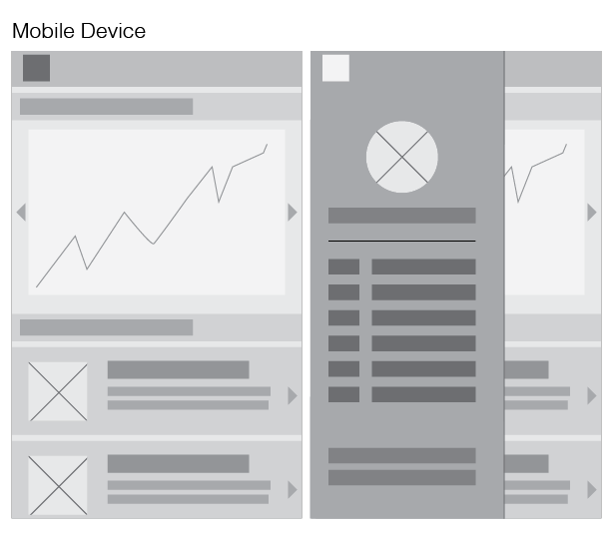
MOBILE LAYOUT OPTION
Notes:
Caitlin

Slide 12
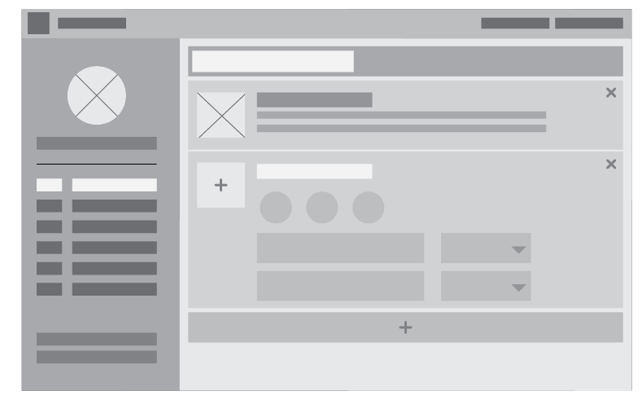
CREATING WORKOUT - LAYOUT OPTION
Notes:
Caitlin

Slide 13
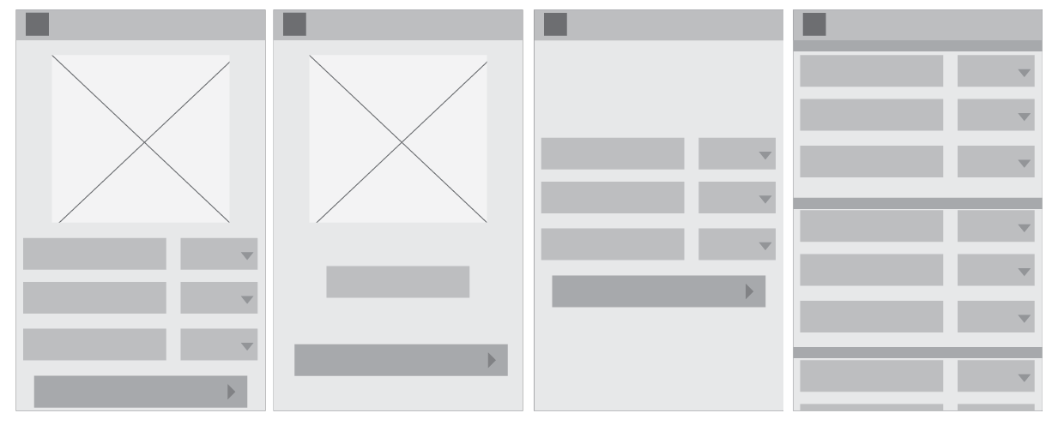
PERFORMING WORKOUT - LAYOUT OPTIONS
Notes:
Caitlin

Slide 14
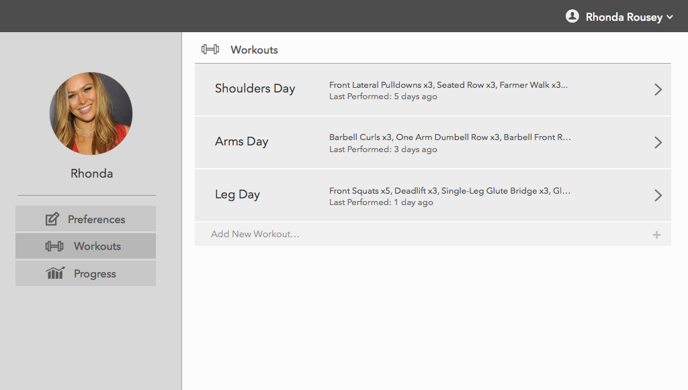
FINAL DESIGN - GOAL
Notes:
Caitlin

Slide 15
5.
TASK ASSIGNMENTS
Notes:
Crystal

Slide 16
TASK ASSIGNMENTS
Caitlin
UI Design, UI Mockups, Frontend Design, Frontend Development, HTML, CSS
Crystal
Initial Workout Page Live Mockups, Frontend JS, Misc. Tasks
Ezra
SysAdmin, Backend, Frontend JS
Kayla
Frontend Design, CSS, Graph Functionality, Presentation Design, Documentation
Stefan
Frontend, Initial Live Mockups, Initial Graph Mockups
Notes:
Crystal

Slide 17
6.
TECHNOLOGIES AND ARCHITECTURE
Notes:
Ezra

Slide 18


Coordination and Source Control
Notes:
Ezra

Slide 19






Frontend
Notes:
Ezra

Slide 20




Backend
Notes:
Ezra

Slide 21
Application Architecture
Dashboard
Register
History
Workouts
Perform
Landing
Preferences
Backend Controllers/Endpoints
MongoDB
Notes:
Ezra

Slide 22
7.
DEMO
Notes:
Caitlin

Slide 23
8.
FUTURE PLANS
Notes:
Caitlin

Slide 24
MANY PEOPLE HAVE EXPRESSED INTEREST IN OUR PROJECT AND WE WOULD PURSUE RELEASING IT
Frontend
Improve mobile functionality
Remove template, start fresh
Change graph framework
Update performing UI
Backend
Consolidate Endpoints
Reorganize Components
Add More Robust Statistics Storage
Notes:
Frontend - Caitlin
Backend - Ezra

Slide 25
9.
CONCLUSIONS
Notes:
Ezra

Slide 26
WHAT WE LEARNED
MEAN is pretty sweet actually
Graph functionality and data manipulation
The use of color
Notes:
Everyone

Slide 27
THANKS!
Any questions?
Notes:
Everyone

